Slide 1
STORYTELLING CASE STUDY: AIRBNB, NYC
- Manish Sahu
- Shilpa N
- Prasanna Jasawala

Slide 2
Objective:
To prepare for the next best steps that Airbnb needs to take as a business, we have been asked to analyse a dataset consisting of various Airbnb listings in New York.
Background:
Airbnb is an online platform using which people can rent their unused accommodations.
During the covid time, Airbnb incurred a huge loss in revenue.
People have now started travelling again and Airbnb is aiming to bring up the business again and be ready to provide services to customers.

Slide 3
Data Preparation
Cleaned data to remove any missing values and duplicates.
Dropped insignificant columns.
Identified outliers
Tools Used:
For the data analysis and visualization we have used following tools
• Python Jupyter Notebook
• Tableau

Slide 4
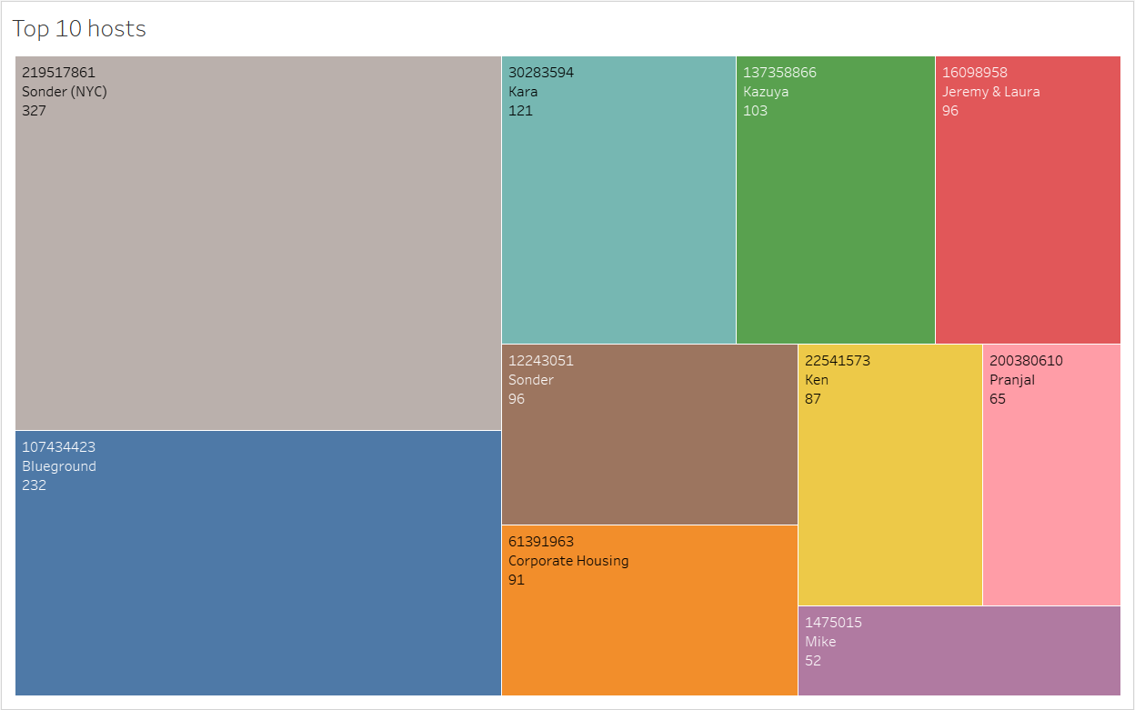
Top 10 Host
Host Sonder (id 219517861), has been booked most number of times i.e. 327.
Host Blueground is the second popular host.
Then there are other hosts like Kara, Ken, Pranjal, Jeremy and Mike that fall under top 10 hosts.

Slide 5
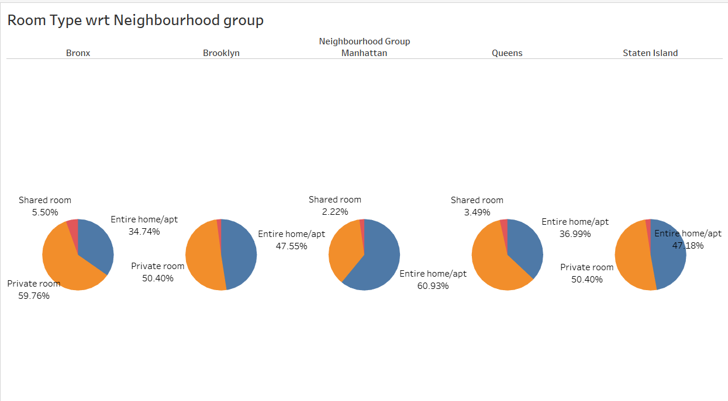
Room type with respect to Neighbourhood group
Manhattan and Brooklyn are top neighbourhood groups and mostly people prefer to book the entire home or private room.
Manhattan has highest number of home/apt properties, i.e. 60.93% of total listed properties.
Maximum number of private rooms are available in Bronx i.e. around 59.76% of total listed properties.
Very less number of shared rooms are available in each Neighbourhood group.

Slide 6
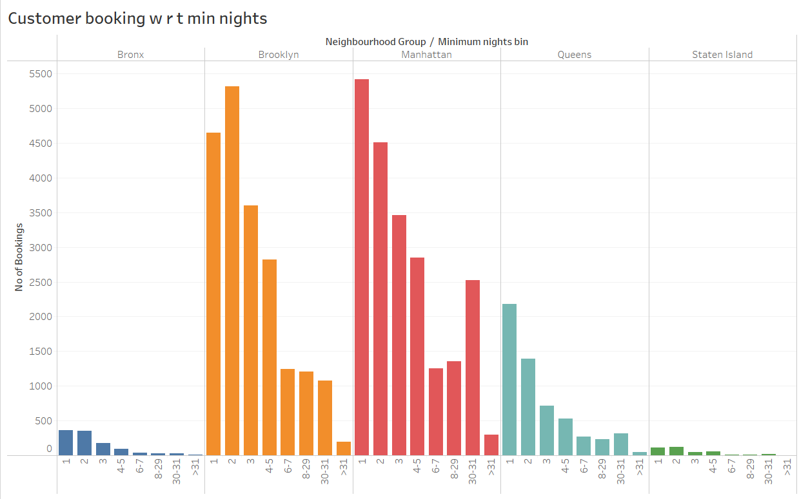
Customer Booking with respect to minimum nights
The listings with Minimum nights 1-5 have the most number of bookings. We can see a prominent spike in 30 days, this would be because customers would rent out on a monthly basis.
After 30 days, we can also see small spikes, this can also be explained by the monthly rent taking trend.
Manhattan &Queens have higher number of 30 day bookings compared to the others. The reason could be either tourists booking long stays or mid-level employees who opt for budget bookings due company visits

Slide 7
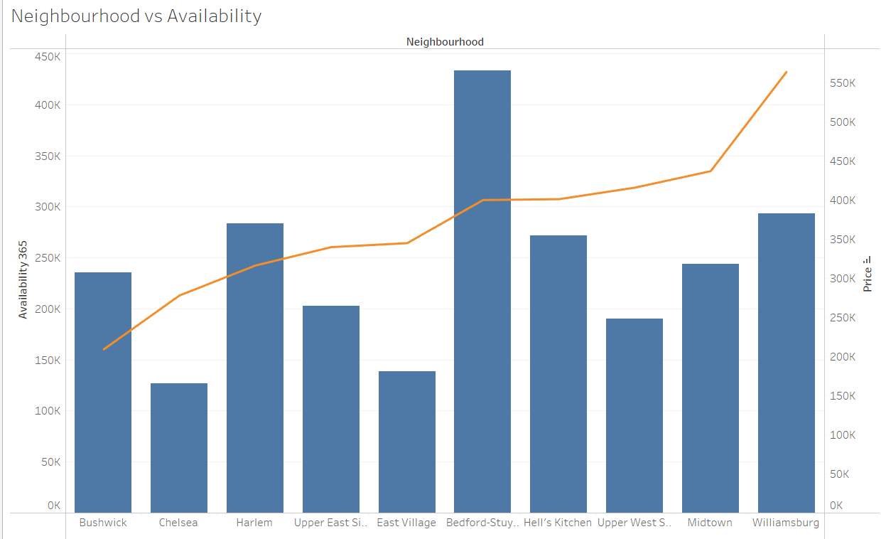
Neighbourhood vs Availability
Availability of Bedford is highest and its price is on the lower side. It is a good choice for customers.
After Bedford, Harlem follows the same trend.
Chelsea’s availability low but it is costly.
On the other hand, William’s price is high and has average availability.

Slide 8
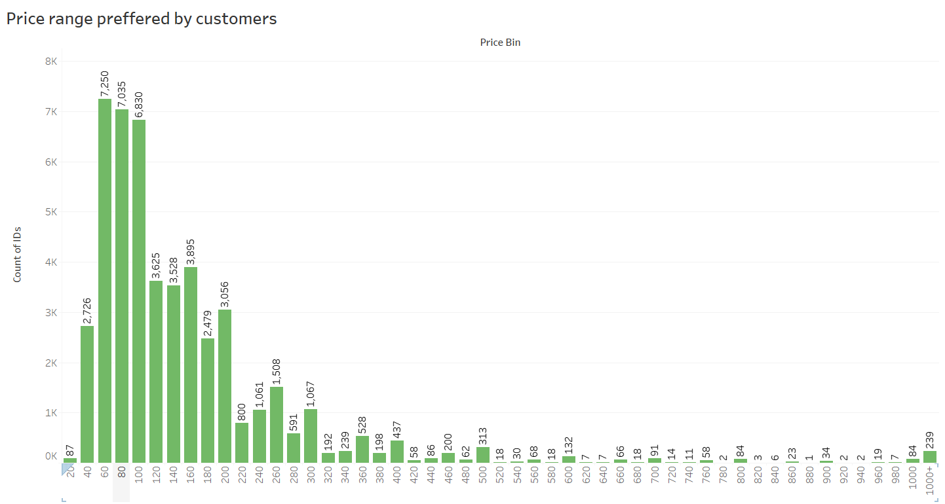
Price range preferred by Customers
We have taken pricing preference based on volume of bookings done in a price range.
From both the graphs, the favourable price range is $60 - $200. This is the price range most preferred by most customers.

Slide 9
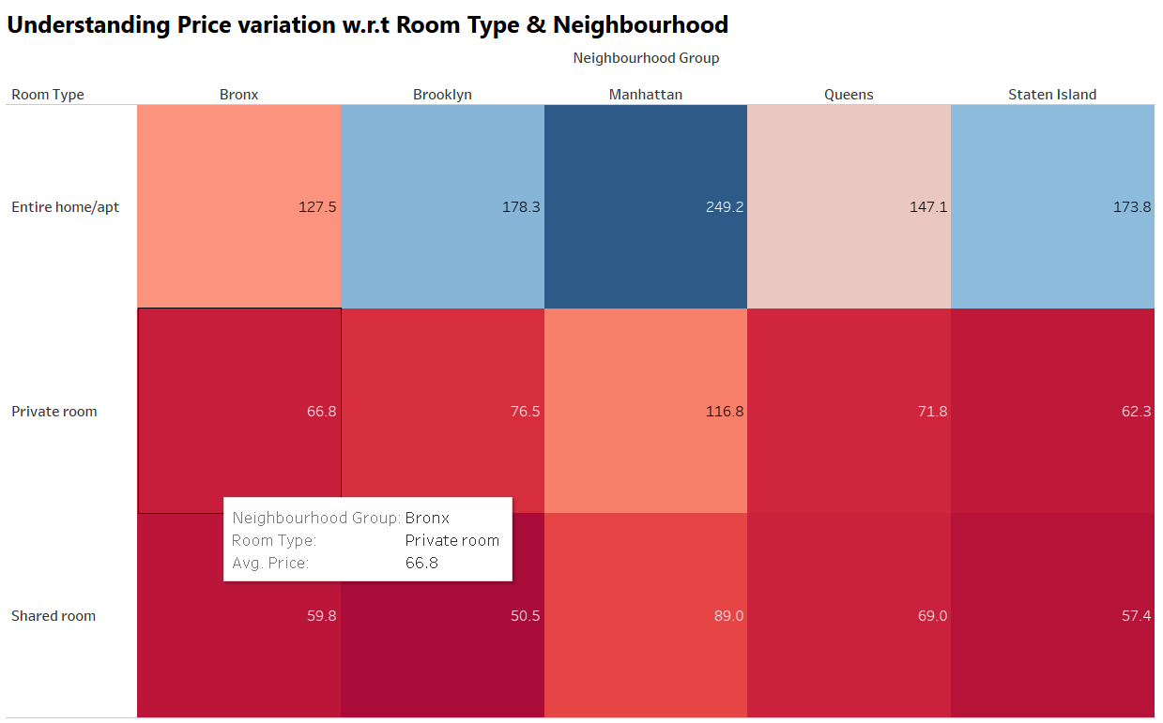
Understanding Price variation w.r.t Room Type & Neighbourhood
The 'Entire home/apt' room type in Manhattan is the most expensive at $250, much higher than the overall average.
‘private rooms’ of Manhattan & Brooklyn has the highest average.
‘Shared Room' type is the cheapest in Brooklyn with $50.5.

Slide 10
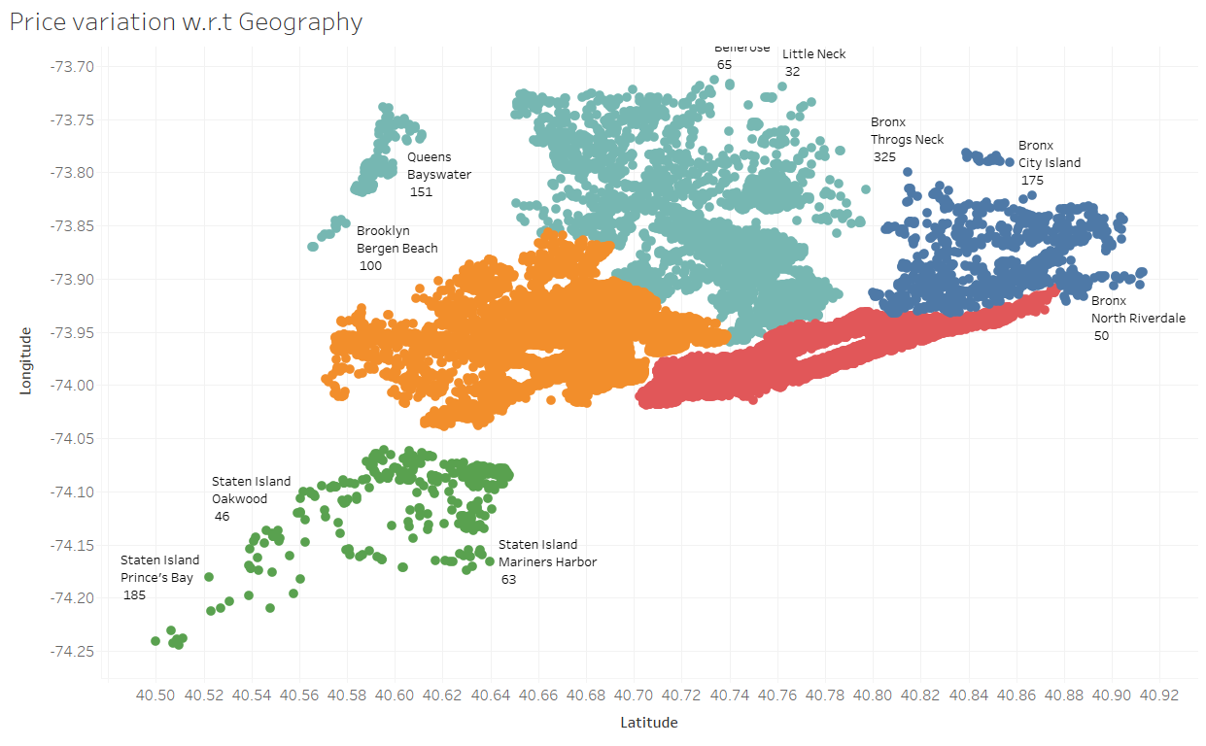
Price variation with respect to Geography
We see that, Airbnb has good presence in Manhattan, Brooklyn & Queens.
Listings are maximum in Manhattan & Brooklyn owing to the high population density and it being the financial and tourism hub of NYC. Staten Island has the least number of listings, due to its low population density and very few tourism destinations.

Slide 11
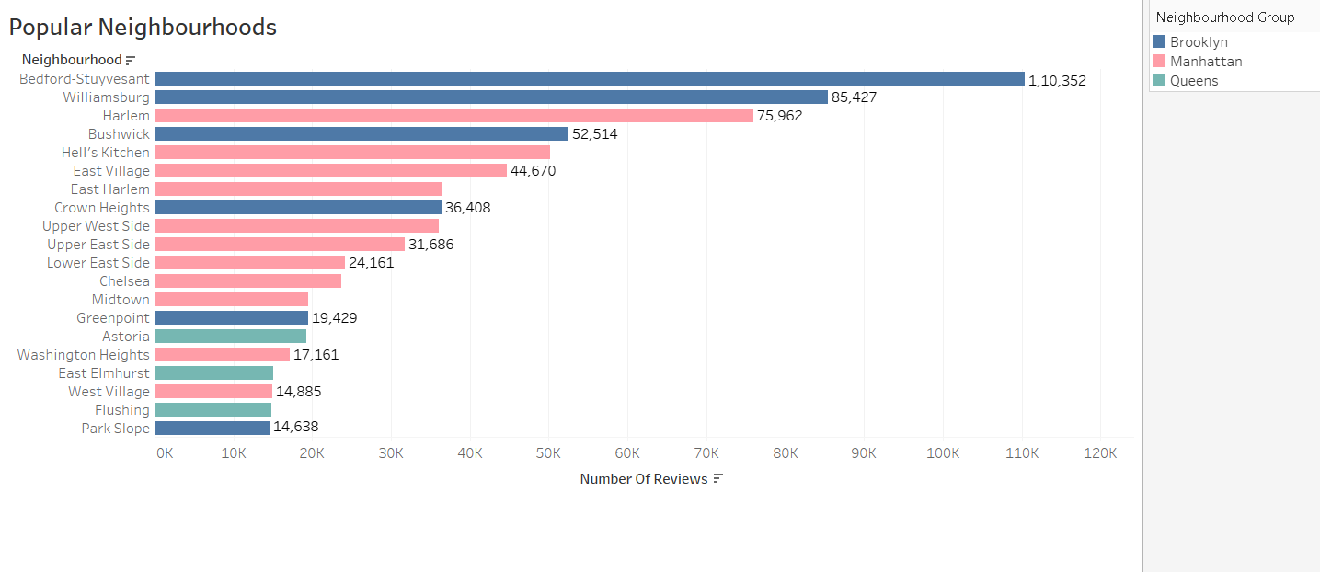
Popular Neighborhoods
We see that Bedford-Stuyvesant from Brooklyn is the highest popular with 1,10,352 no of reviews in total followed by Williamsburg.
Harlem from Manhattan got the highest no of reviews followed by Hell’s kitchen.
The higher number of customer reviews imply higher satisfaction in these localities.

Slide 12
Recommendations:
Promotion of shared rooms with targeted discounts to increase bookings.
More number of hosts & listings with monthly rental duration (30-60-90) can be acquired. We see a good potential in the 30-day rental window. Manhattan & Brooklyn have higher number of 30-day bookings compared to the others; these areas can be further targeted.
Weekly or bi-weekly rentals can also be acquired, as these can be used customers stranded in NYC for quarantine purposes.
New acquisitions and expansion can be done in the price range of $40 -$190 as it satisfies both parameters of volume of customer traffic and customer satisfaction.
New acquisitions can be explored to acquire ‘private rooms’ in Manhattan and Brooklyn and ‘entire homes’ in Bronx and Queens.
Brooklyn has an average price of $124. As there are already many listings available in Manhattan, Brooklyn can be considered for expansion.
Increasing acquisitions and new properties in coastal regions can increase customer bookings.

